Slide 1
Attention & Perception
UNIT-3

Slide 2
Attention
Attention is a state of consciousness in which a person can respond to a stimulus or stimuli.
In psychology, a stimulus can be a required task, an object, or an event that requires a response.
Attention is a combination of how long a person can focus and how many things they can focus on.

Slide 3
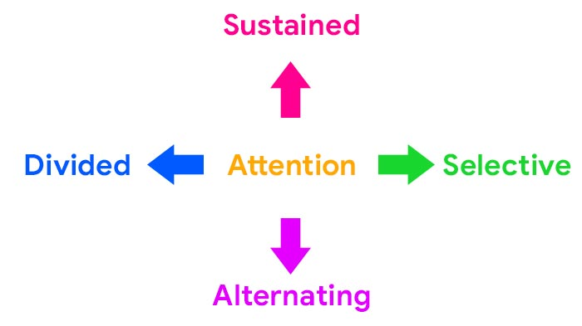
Types of Attention

Slide 4
Four different types of attention
There are four different types of attention that we’ll define: sustained, divided, selective and executive.
Sustained Attention
Sustained attention means focusing on a person, task or activity for a certain time or until the relevant conversation, task or activity is complete. Another example is when we learn through studying and writing tests and exams.
Another related type is known as focused attention, which involves being able to rapidly respond to external stimuli, such as loud noises.

Slide 5


Slide 6
Divided Attention
This involves trying to focus on many different conversations, tasks and activities at the same time, also known as multitasking.
Although a common practice, it’s rarely effective, as we only have so much energy to devote to each task.
Related to this is alternating attention.
It is similar to multitasking, but involves seamlessly moving from one task to another, instead of dividing your focus.

Slide 7
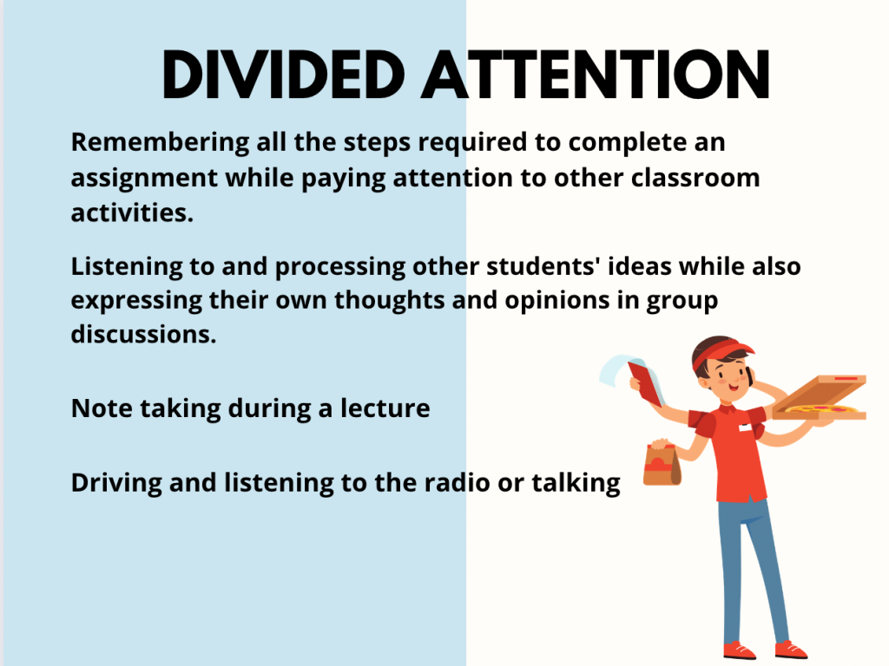

Slide 8
Selective Attention
Selective attention involves being able to focus on a specific task while simultaneously being able to block out any background noise or stimuli. This can be a difficult skill to master, depending on your level of sensitivity, but is a valuable tool in being able to function in a noisy world!
One example includes being able to read a book while there is loud background noise around you. However, it can also refer to not engaging with inner stimuli such as thoughts.

Slide 9
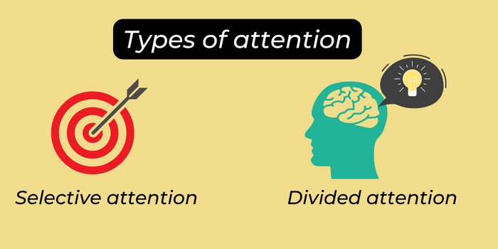

Slide 10
Executive Attention
Executive attention is similar to selective attention, as it involves being able to block out distractions and focus on a specific task. However, the difference is that this way of focusing also involves ruthless prioritization and only focusing on activities that will help to achieve a certain goal.
For example, the managing director of a company can’t attend to everything that is going on, but they can block out all the hundreds of emails they receive and devote themselves to completing the critical tasks of the day.

Slide 11
Factors Influencing Attention:
Salience: How noticeable or relevant a stimulus is in the context (e.g., bright colors, loud noises).
Interest: Personal relevance and emotional connection can enhance attention.
Cognitive Load: The amount of mental effort required can affect how well we can focus.

Slide 12
Factors affecting attention
There are several factors that can affect attention.
Each of these factors can increase or decrease a person’s attention to a certain object, person or concept.
These could be classified under two broad categories namely external factors and internal factors
External factors
Factors which are present outside the stimuli or situation refer to external factors. These can also be called as objective factors.

Slide 13
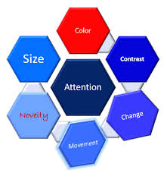

Slide 14
Motion: Adults and children are more likely to pay attention to an object when there is motion involved
Size: Size has an effect on attention. Objects or text that is larger gain more attention than normal or small objects. At the same time very small objects too draws our attention when compared to normal size.
Intensity: Intense objects attract our attention. Loud sound, bright objects and strong smell draws our attention easily.
Contrast: Anything that is different from its surroundings is contrast. A black dust in white sugar draws more attention
Novelty: New things attract people more

Slide 15
Emotion: Words with strong emotional connections seem to gain more attention than others.
Personal Significance: A person is more likely to pay attention to a person or concept that has a personal significance to them. Example: If a person suffers from a disease, they are more likely to pay attention to a lecture about that disease, because they know how it could affect their lives.
Social cues: People are more likely to pay attention to things they see others looking at or reacting to

Slide 16
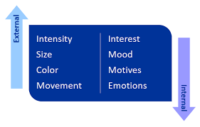

Slide 17
Internal factors
Internal factors are concerned with the individual.
Hence it is also called as subjective factors.
The factors are:
Interest: People always give more attention to stimuli or situation in which they are interested. Interesting things draws our attention immediately
The interest of a person plays a key role in determining one’s attention. Each of our interests may be regarded as a powerful stimulus to draw our attention to a particular thing, person or an activity

Slide 18
Desire: People pay attention to things which they desire for.
When we go to a shop we give more attention to materials that we desire to buy than to other materials.
Motives: Basic motives are so powerful and are important in drawing attention. A person who is hungry will pay more attention to places where food is available.
Goal: People will be paying attention to activities which will help them to achieve their goal. Students pay more attention to studies before examination as their goal is to pass/ excel in the examination
Past experience: It is also a factor that influences attention. For example, the past experiences with certain persons make us think that they are sincere and we may give attention to their communication than to people who were not sincere to us.

Slide 19

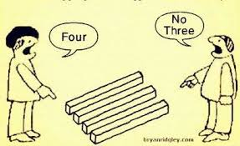

Slide 20
Perception
Definition: Perception is the process of interpreting and organizing sensory information to understand the environment.
It involves not just the raw data received through our senses, but also the cognitive processes that give meaning to that data.
Stages of Perception:
Sensation: The initial detection of stimuli through sensory organs (e.g., seeing light, hearing sound).
Attention: Selecting which sensations to focus on.
Interpretation: Making sense of the sensory information, influenced by past experiences, expectations, and context.

Slide 21
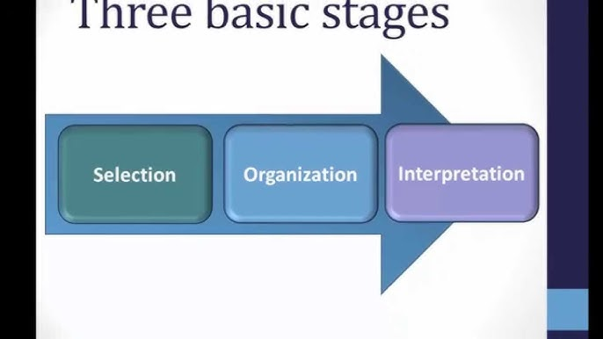

Slide 22
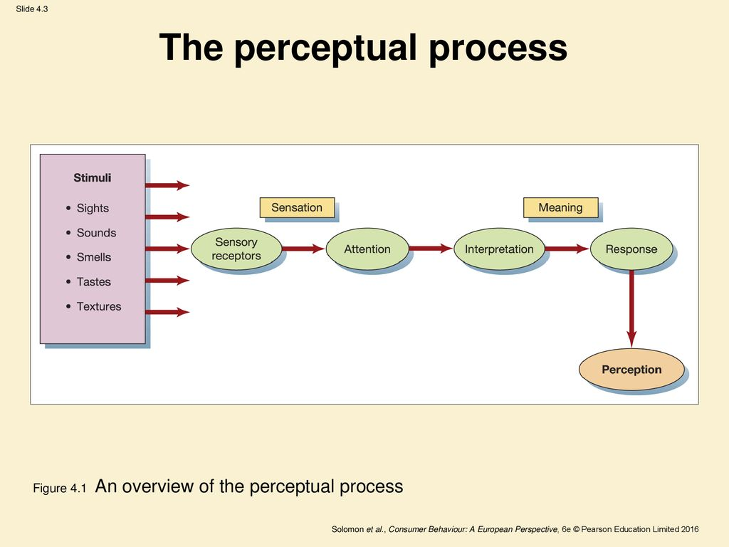

Slide 23
Factors Influencing Perception:
Context: The environment and surrounding stimuli can alter how we perceive a particular stimulus (e.g., the same color may look different under different lighting).
Expectations: Preconceived notions can affect perception (e.g., expecting a certain outcome may influence how we interpret ambiguous information).
Cultural Background: Cultural differences can shape how we interpret and respond to various stimuli.

Slide 24
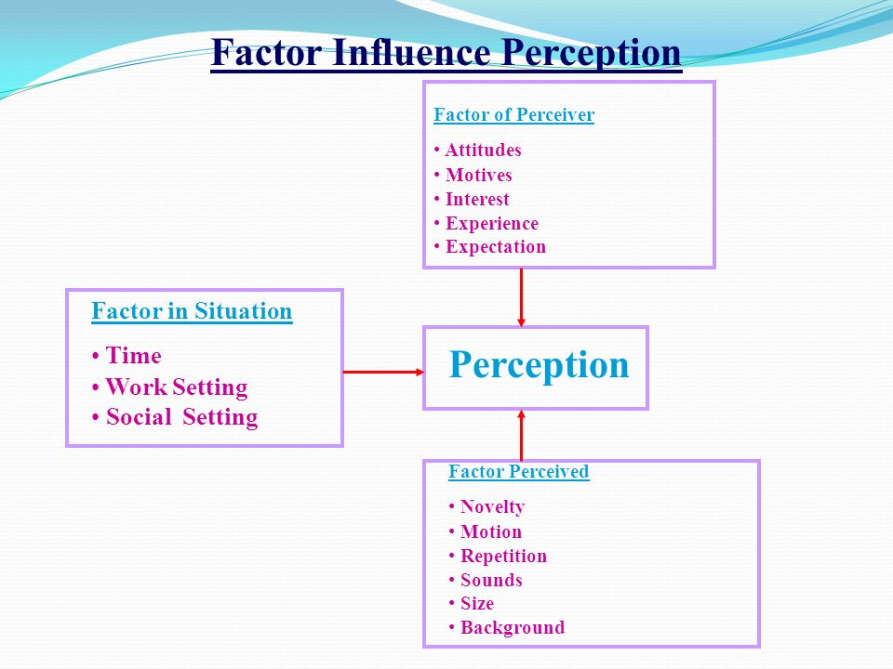

Slide 25
i) Factors in the perceiver (perceiver variables)
ii) Factors in the target (subject characteristics)
iii) Factors in the situation (situational variables).
Factors in the perceiver include following issues:
• Self-concept of the perceiver;
• Attitudes of the perceiver;
• Motives of the perceiver;
• Interests of the perceiver;
• Experience of the perceiver;
• Expectations of the perceiver.

Slide 26
Factors in the target include following issues:
• Physical appearance
• Verbal and Nonverbal Communication
• Status
• Occupations
• Personal characteristics
• Novelty of the target
• Motion of the target
• Sounds of the target
• Size of the target
• Background of the target
• Proximity of the target

Slide 27
Factors in the situation include following issues:
• Social context
• Organizational role
• Work setting
• Location of event
• Time

Slide 28
Perception can be categorized in various ways, reflecting how we interpret and understand sensory information. Here are some key types of perception:
Visual Perception
Description: The ability to interpret and make sense of visual stimuli, including shapes, colors, depth, and motion.
Examples: Recognizing faces, reading text, and interpreting visual art.
Auditory Perception
Description: The process of interpreting sounds, including pitch, volume, and timbre.
Examples: Understanding spoken language, identifying music notes, and distinguishing different sounds in an environment.
Tactile Perception
Description: The ability to perceive touch sensations through skin receptors.
Examples: Feeling texture, temperature, pressure, and pain.

Slide 29
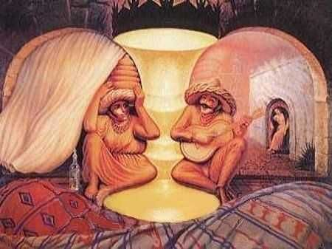

Slide 30
Olfactory Perception
Description: The sense of smell and the ability to identify and differentiate odors.
Examples: Recognizing the smell of food, perfumes, or natural scents.
Gustatory Perception
Description: The sense of taste and how we interpret flavors through taste buds.
Examples: Distinguishing between sweet, sour, salty, bitter flavors.
Kinesthetic Perception
Description: The awareness of body position and movement, often referred to as proprioception.
Examples: Knowing where your limbs are without looking, coordinating movements in sports.

Slide 31
Social Perception
Description: The process of interpreting and understanding social cues and behaviors.
Examples: Reading body language, understanding emotions in others, and interpreting social dynamics.
Environmental Perception
Description: How we perceive and interpret our surroundings, including spatial awareness and navigation.
Examples: Understanding geographical layouts, recognizing landmarks, and sensing distances.
Temporal Perception
Description: The perception of time and how we experience its passage.
Examples: Noticing the duration of events, the speed of moving objects, and the timing of rhythms in music.

Slide 32
The principles of perception
The principles of perception describe how we organize and interpret sensory information. Here are some key principles that guide our perceptual processes:
Figure-Ground Relationship
Description: This principle involves distinguishing an object (the figure) from its background (the ground). Our brain tends to separate elements to focus on the most relevant part of a scene.
Example: In a picture with a face against a complex background, we perceive the face as the figure and the background as the ground

Slide 33


Slide 34


Slide 35
Grouping
Description: Our minds tend to organize stimuli into groups based on certain characteristics. This can include proximity, similarity, continuity, closure, and connectedness.
Proximity: Objects close together are perceived as a group.
Similarity: Similar objects are grouped together.
Continuity: Lines are perceived as following the smoothest path.
Closure: Incomplete shapes are perceived as complete.
Connectedness: Elements that are linked are seen as a single unit.

Slide 36
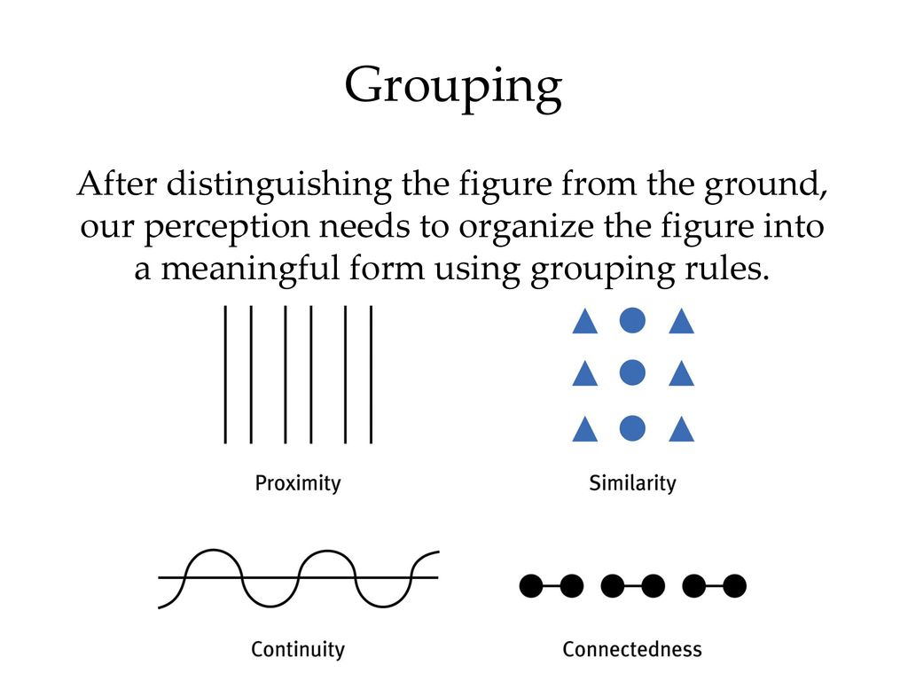

Slide 37
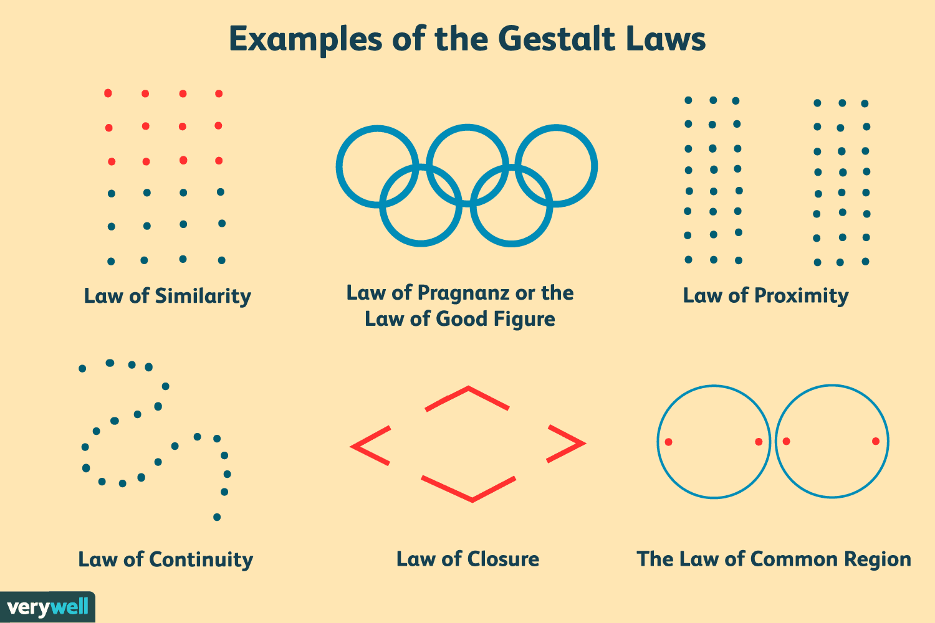

Slide 38
Depth Perception
Description: This principle allows us to perceive the world in three dimensions and judge distances. Depth cues can be binocular (using both eyes) or monocular (using one eye).
Example: Binocular cues include retinal disparity (the difference between images from each eye), while monocular cues include size, overlap, and perspective.

Slide 39
Constancy
Description: Perceptual constancy refers to our ability to perceive objects as stable and unchanging despite variations in sensory input. This includes:
Size Constancy: Objects are perceived as the same size despite changes in distance.
Shape Constancy: Objects are perceived as having the same shape, even when viewed from different angles.
Color Constancy: The perceived color of an object remains the same under varying lighting conditions.

Slide 40
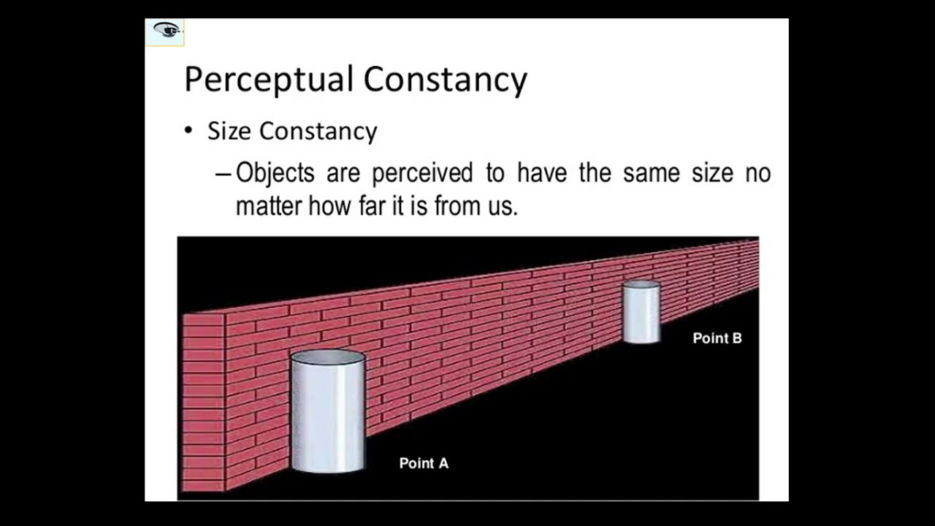

Slide 41
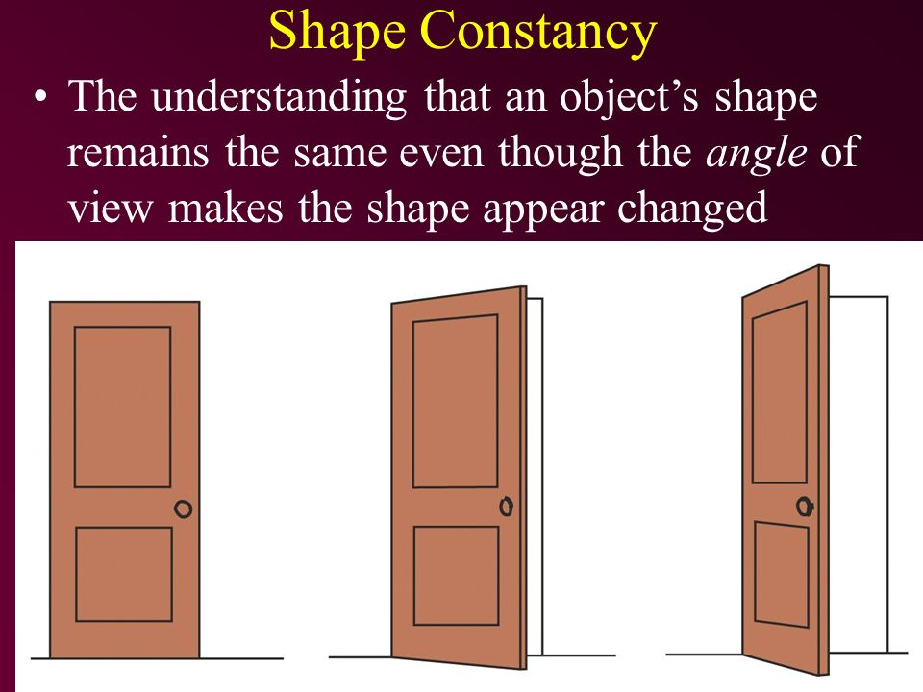

Slide 42
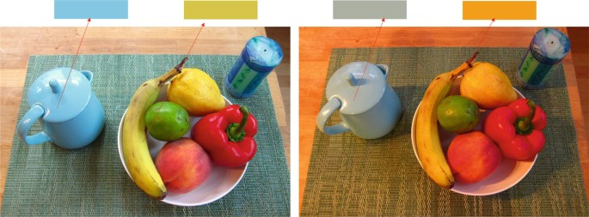
Colour constancy

Slide 43
Perceptual Set
Description: This principle refers to a predisposition to perceive things in a certain way based on expectations, experiences, and context.
Example: If someone is told to look for a specific shape, they are more likely to notice that shape even in a complex image.

Slide 44
Top-Down Processing
Description: This principle emphasizes the role of prior knowledge, experience, and expectations in shaping our perception. Our brain uses context to interpret sensory information.
Example: Reading a sentence with missing letters can still be understood because our brain fills in the gaps based on context.
Bottom-Up Processing
Description: This approach focuses on the sensory input itself and how it is processed to form a perception. It starts with the details and builds up to a complete perception.
Example: Recognizing a familiar object by identifying its individual features (like color, shape, and texture).

Slide 45
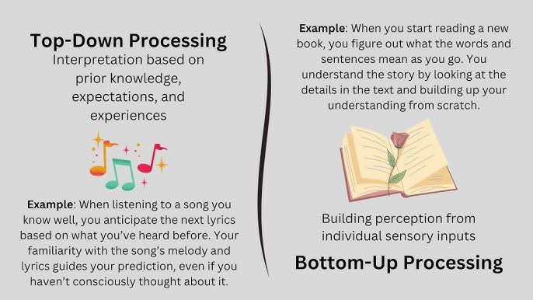

Slide 46
Factors influencing perception
Sensory Input
Intensity: More intense stimuli (e.g., bright lights, loud sounds) are more likely to be noticed and attended to.
Contrast: Differences in stimuli (e.g., contrasting colors or sounds) can enhance perception.
Attention
Focused Attention: What we choose to focus on can significantly alter our perception. Selective attention filters out distractions and highlights specific details.
Divided Attention: Attempting to process multiple stimuli can lead to misinterpretations or missed information.

Slide 47
Past Experiences
Learning and Memory: Previous experiences shape how we perceive new stimuli. Familiarity can lead to quicker recognition and interpretation.
Cognitive Schemas: Mental frameworks built from past experiences influence how we interpret new information.
Expectations and Context
Expectations: What we expect to see or experience can shape our perceptions. Our brains use prior knowledge to interpret ambiguous stimuli.
Context: The surrounding environment and situational factors can affect how we perceive specific stimuli (e.g., a color may look different depending on its background).

Slide 48
Cultural Background
Cultural Influences: Different cultures can shape perceptions, including interpretations of emotions, social cues, and visual stimuli.
Social Norms: Cultural norms influence how we interpret behaviors and interactions, affecting our perceptions of social situations.
Motivation and Emotion
Motivation: Personal goals and desires can influence perception. We are more likely to notice stimuli that align with our interests or needs.
Emotional State: Current emotions can alter perceptions. For example, feeling happy may lead to a more positive interpretation of ambiguous situations.

Slide 49
Social Influences
Social Interactions: Feedback and reactions from others can shape our perceptions of situations and ourselves.
Group Dynamics: Being part of a group can influence how we perceive others and situations, often leading to conformity or groupthink.
Physiological Factors
Biological Differences: Individual differences in sensory systems (e.g., vision, hearing) can affect how we perceive the world.
Health Conditions: Certain medical conditions can impact perception, such as color blindness or hearing impairments.

Slide 50
Errors in Perception
Perceptual errors, also known as optical illusions, are systematic errors in the way we perceive figures or scenes. They occur when the perceptual processes that help us perceive the world around us are fooled by a situation. For example, we might see something that doesn't exist or is incorrect.
Examples of perceptual errors:
Haze
Haze, which can be caused by atmospheric dust particles, fog, or water vapors, can make it seem like objects are closer or farther away than they actually are.
Visual masking
A second brief stimulus, called the "mask", can reduce or eliminate the visibility of a first brief stimulus, called the "target"

Slide 51
Binocular rivalry
This occurs when different images are presented to each eye, causing an unintentional alternation between them
Spatial disorientation
This occurs when a person's perception of position and motion doesn't match reality
Hallucinations
Perceptions that are not based on sensory input, and involve experiencing something that doesn't exist.
For example, hearing voices or seeing imaginary objects. Hallucinations are typically experienced by an individual and are mostly subjective experiences.

